Slide 1


Final Demo Presentation
Holden Haile
- Power Supply

Slide 2

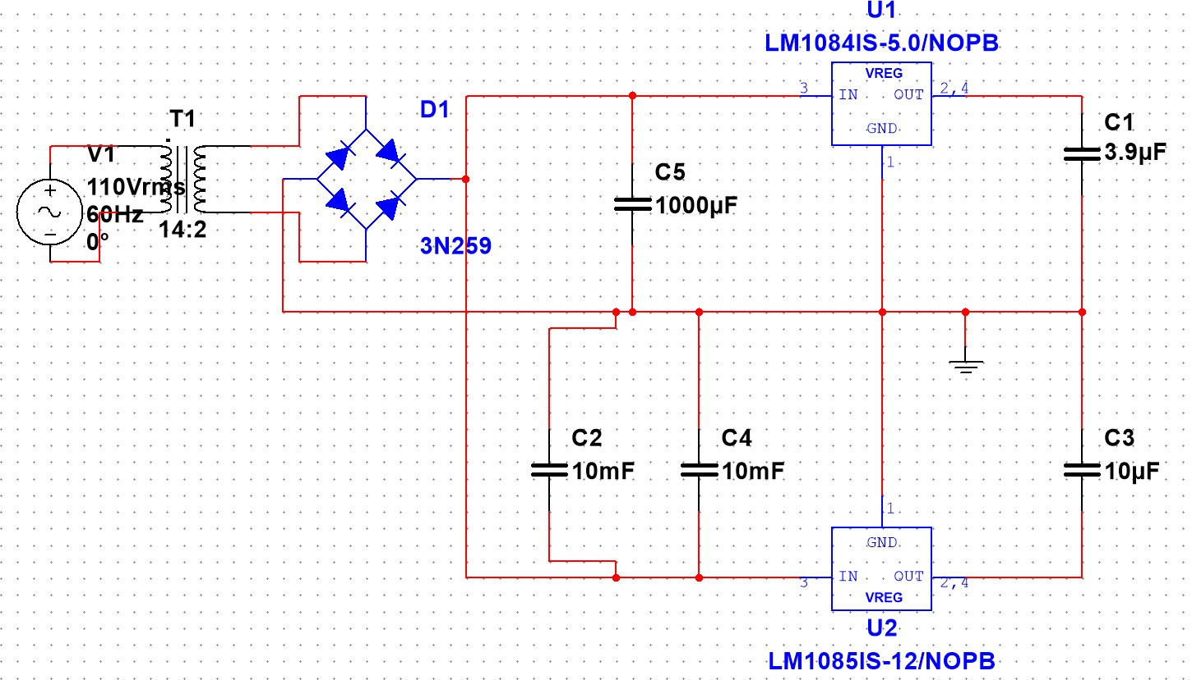
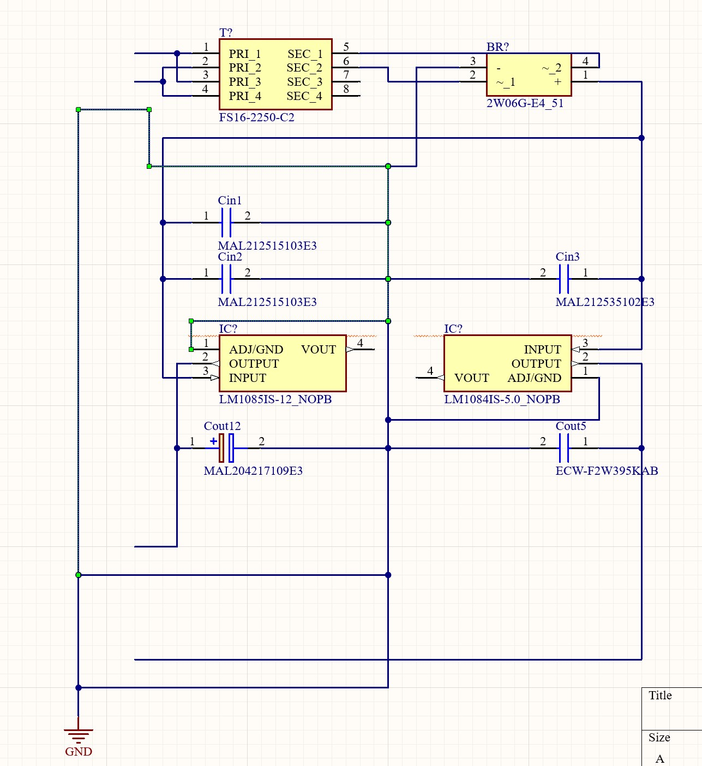
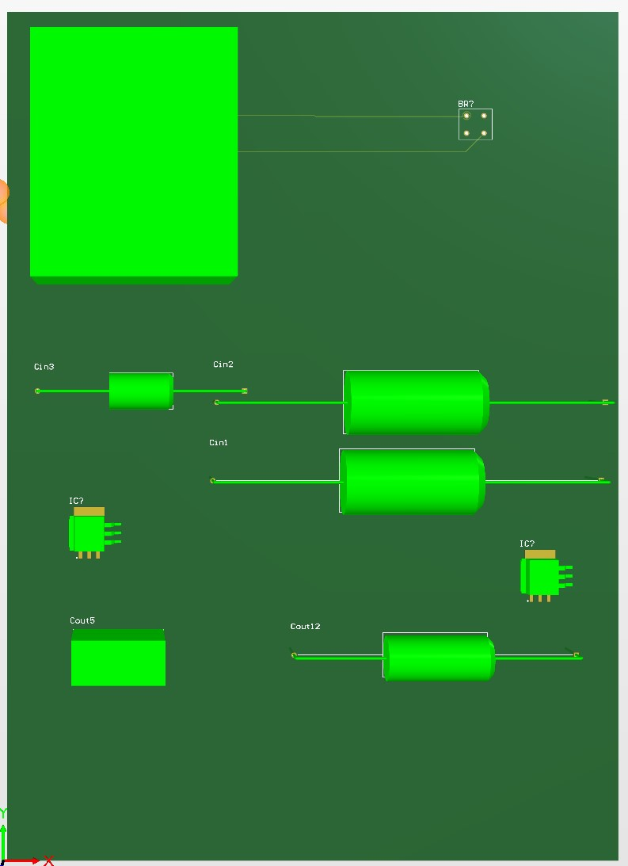
Initial Design
Top – Multisim Schematic
Bot left – Altium Schematic
Bot Right – PCB 3D View

Slide 3

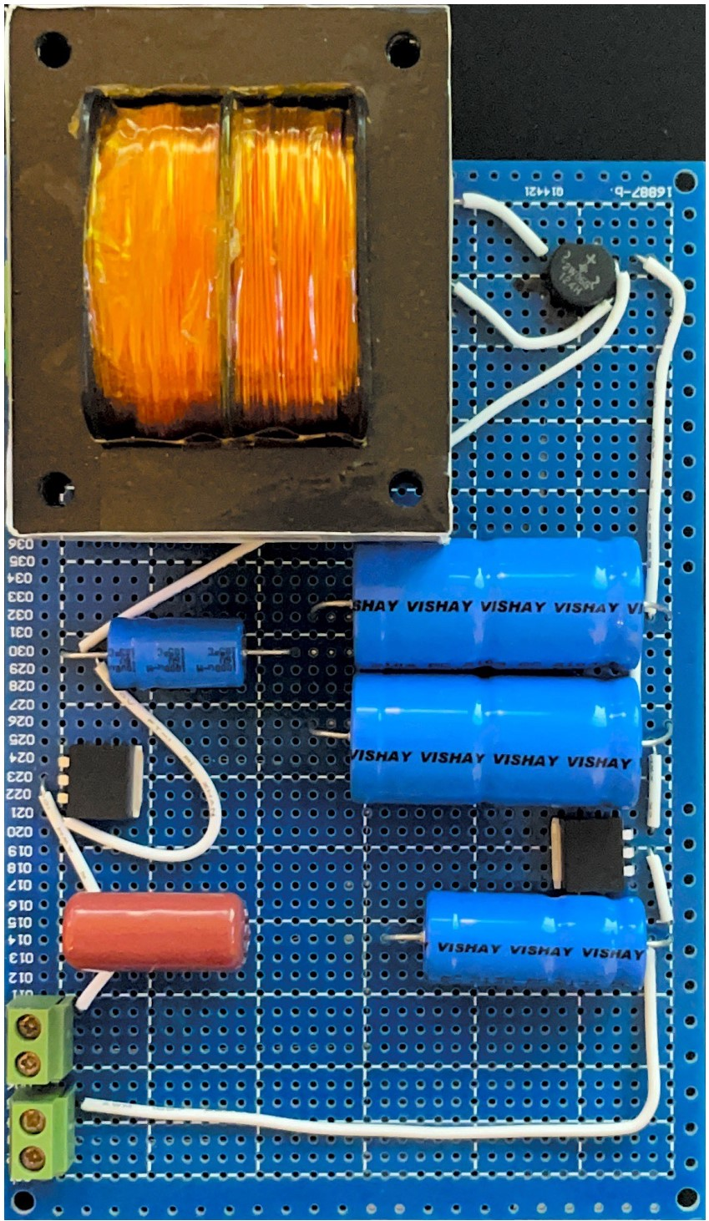
Overall Design
Transformer – 7.5 turns ratio
Full Bridge Rectifier
Input Capacitors –
2 x 10mF
1mF
Voltage Regulators
12V
5V
Output Capacitors
10uF
3.9uF

Slide 4
Current Situation
Problems:
Overstraining the voltage regs
Overheating full bridge rect
Solutions:
Replace the current transformer for a lower output 10x transformer
Replace the full bridge with a more durable component

Slide 5
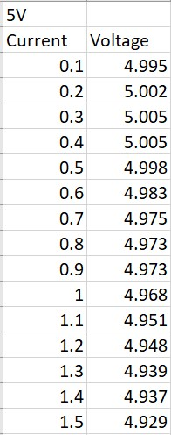
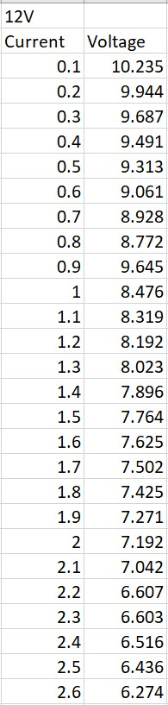
Validation
Output 5V – Tested – Passed
Output 12V – Tested – Passed
E-load Max/Min – Tested – Partial
Sustained Load – Tested – Failed
The test results shown are for the revised configuration in an effort to take strain off the voltage regulators I halved the voltage out of the transformer, but this caused a significant drop out of the 12V buck converter

Slide 6

Final Demo Presentation
Abhi Singh
Sugar Dispenser

Slide 7
Validation
Phases:
Wifi Connection Stability (reconnection)
MQTT connected Status (reconnection)
Skittle Dispenser Accuracy
3, 5, 10 skittle requests
Confirmation to App
Liquid Dispenser Accuracy
50 ml, 80ml. 100ml
Power Draw within limit

Slide 8
Final Demo Presentation
Kelton Chesshire
- Mobile Application

Slide 9
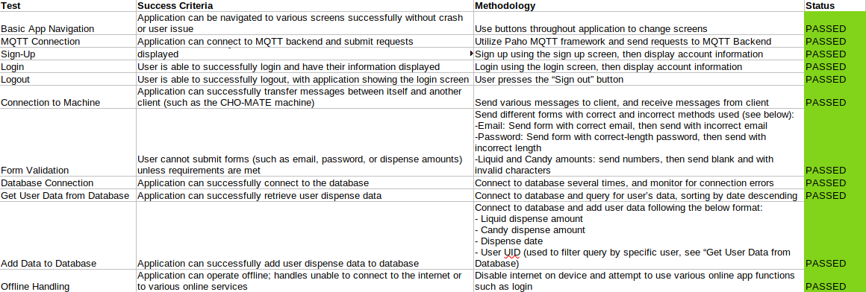
Validation
Phases:
Basic App Navigation
Authentication (Login, Logout)
Sign Up
Form Validation
Database Connection
Connecting with Machine
Error Handling

